Slide 1

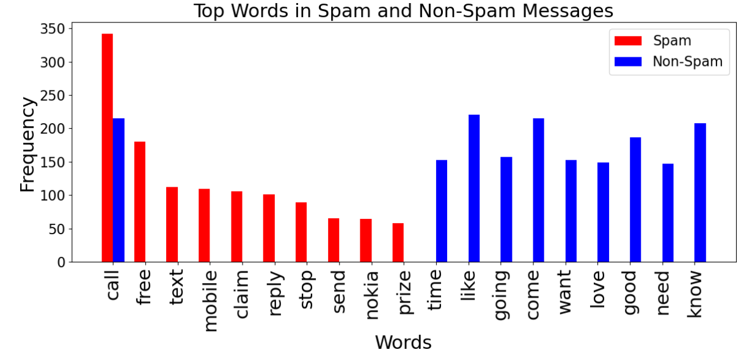
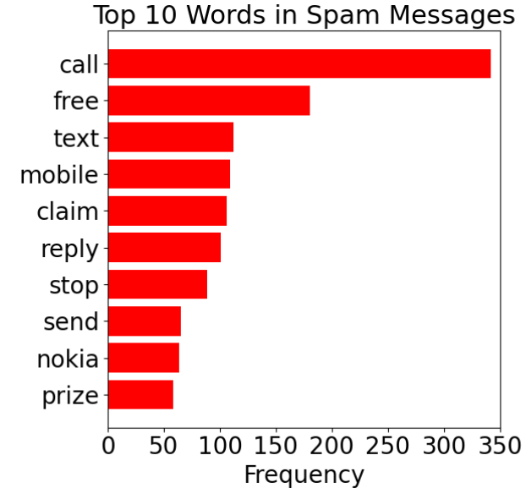
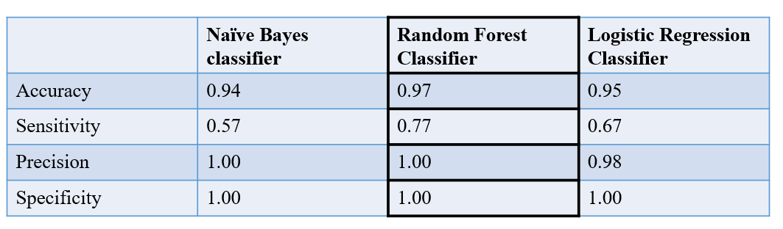
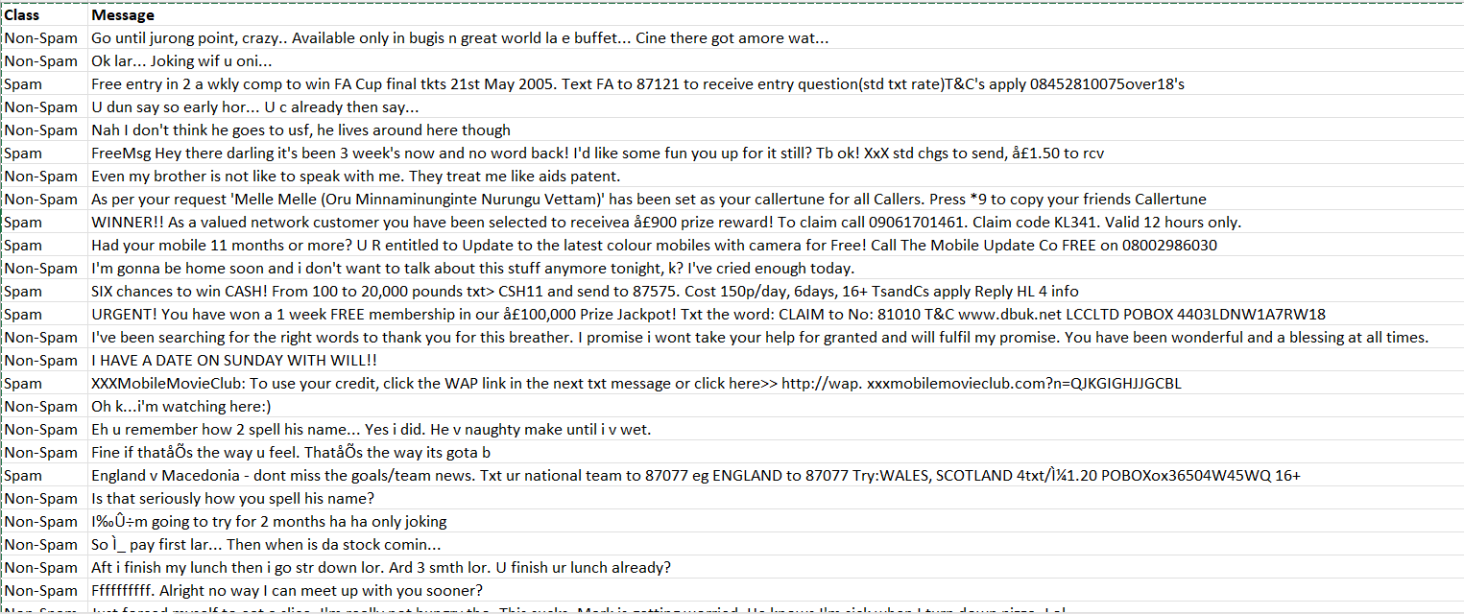
Analysis of Spam and Non-Spam Text Messages
Devi Varaprasad Abdas
Master of Applied Security and Analytics
Abstract
Outcomes
Statistics
Spam messages, which are frequently seen as digital annoyances, comprise a wide range of uninvited and unwanted communication sent through different digital channels like social media, text messaging, and emails.
This analysis consists of analyzing text messages received by users and categorizing if they are spam or non-spam messages.
Data Visualizations
Random Forest was considered the best classifier based on its validation accuracy compared to Naive Bayes and Logistic Regression. However, model selection should not solely rely on accuracy. Other metrics like precision, recall, and F1-score should also be considered. Additionally, cross-validation can help in selecting the best model.
Research Questions
Regular text (Non-Spam) messages might have similar content as Spam messages, so how can we distinguish if it's Spam or not?
Which analysis method provides effective distinction between Spam and Non-Spam text messages?
These images display bar graphs showing the frequency and the comparison of the most common words found in spam messages after data cleaning, with “call" being the most frequent word among the listed top 10.
Next Steps
Model Evaluation
Further study is needed to modify hyper parameter values including the threshold.
Additional study is needed on how imbalanced data sets in machine learning methods are affecting the results.
Data Description
Messages in the dataset are classified as 'Spam' or 'Non-Spam' based on various features.
Spam messages often include unsolicited promotions, urgent requests for action or personal information, hyperlinks to questionable websites, and may contain an abundance of sales language or be part of a bulk mailing. They might also use misleading subject lines, excessive capitalization, and special characters to draw attention.
In contrast, Non-Spam messages, also known as 'Ham’, typically involve everyday language and pertain to genuine communication between individuals, displaying a natural flow of conversation without aggressive marketing tactics or suspect content.
The dataset was randomly partitioned into the following: Training (40%), Validating (30%), Testing (30%).
The table below describes the data partitions with respect to the target feature values, where there were 6182 records before data cleaning and 5572 records after the data cleaning.
This is a sample dataset where data, categorized into Spam and Non-Spam messages, was retrieved from Kaggle. In the dataset, each row consists of the class (Spam or Non-Spam), followed by the message, with the class and message fields being comma-separated.
Conclusions
The Random Forest Classifier performed well across various metrics, demonstrating reliability in distinguishing between spam and non-spam instances. The balanced nature of accuracy, sensitivity, precision, and specificity suggests that the Random Forest Classifier approach was the most effective in handling the complexities of the dataset. Regular monitoring and potential refinement of rules may further enhance the model's performance in real-world applications.
Data Cleaning Steps
Preprocess Text: Convert messages to lowercase, remove punctuation/special characters.
Handle Duplicates and Missing Values: Check for and remove duplicate messages; fill in or remove missing values in "Class" or "Message".
Encode Categories: Transform "Class" into a numerical format for analysis; 0 is Non-Spam, 1 is Spam
References
Data Mining
Devastator, T. (2022, November 21). SMS Spam Collection (text classification). Kaggle. https://www.kaggle.com/datasets/thedevastator/sms-spam-collection-a-more-diverse-dataset
Truecaller insights 2022 U.S. Spam & Scam Report. Truecaller Blog. (n.d.). https://www.truecaller.com/blog/insights/truecaller-insights-2022-us-spam-scam-report
Exploratory Analysis: Examine the balance of spam vs. non-spam messages and identify frequent words in each category.
Feature Extraction: Use BoW (Bag of Words) or TF-IDF (Term Frequency-Inverse Document Frequency) to convert text messages into a numerical format that models can interpret.
Model Building: Apply classification algorithms (e.g., Naïve Bayes, Logistic Regression, Random Forest Classifier) to distinguish between spam and non-spam messages.
Evaluate and Optimize: Measure model performance with a confusion matrix for Accuracy, Sensitivity, Precision and Specificity.

